Slide 1
A Look at the Economic Impact of Agriculture
David Marrison, Professor and Field Specialist - Farm Management Interim Director for Farm Financial Management and Policy Institute

Slide 2

Objective
To share insight on the economic impact of Ohio Agriculture and for the 16 counties making up EODA.

Slide 3


A Look at Ohio Agriculture

Slide 4
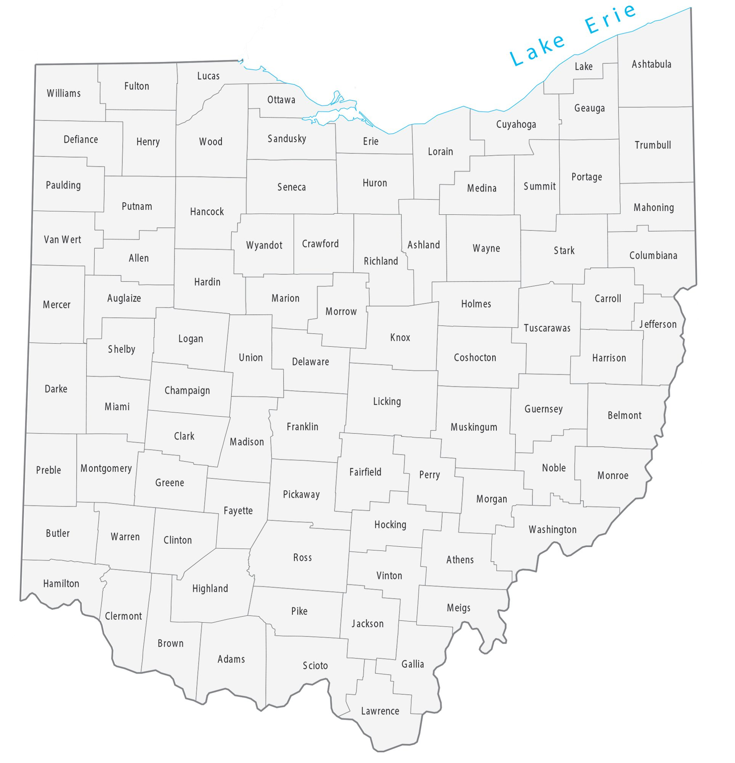
A Look at Ohio Agriculture
Number of Farms: 76,009
Producers: 132,912
Total Acres: 13,652,346
Average Acres/Farm: 180
Market Value of
Ag Products Sold: $15.5 Billion
Average/Farm: $204,567
Source: 2022 Census of Agriculture
Notes:
Farms down from 77,805 to 76,009
Land in farm down from 13,965,295 to 13, 652,346
Acreage size up from 179 to 180
Market Value of Ag Products sold up from $9.7 billion to $15.4
Average per farm is up to $202,767 from $124,572

Slide 5
Ohio Land and Buildings
Estimated value of land and buildings is $109.8 billion.
31.9% of assets owned by farms with 259 acres or less.
39.5% of assets owned by farms with greater than 1,000 acres.
Source: 2022 Census of Agriculture

Slide 6
Ohio Machinery and Equipment
Estimated value of machinery and equipment is $11.95 billion.
41.6% of assets owned by farms with 259 acres or less.
30.1% of assets owned by farms with greater than 1,000 acres.
Source: 2022 Census of Agriculture
Notes:
3.% of total value of sector related to governmental payments
37% of producers report receiving payments
Over 90% of operations over 1,000 receive payments compared to smaller farmers of 7.6% of 1-9 acres, 20.4% of 10-49 acres,31.15 of 50-69

Slide 7
Ohio Farm Size
48.1% of operations have 50 acres or less.
85% of operations are 259 acres or less.
3.5% of operations farm greater than 1,000 acres with 1.2% farming over 2,000 acres.
1-99 Acres
66.0%
100-259 Acres
19.0%
260-499 Acres
6.9%
Source: 2022 Census of Agriculture
500-999 Acres
4.4%
1,000-1,999 Acres
2.4%
Over 2,000 Acres
1.2%
Notes:
2022
2017 Ohio Farm Size
47.4% of operations have 50 acres or less.
83.9% of operations farm 259 acres or less.
2.5% of operations farm greater than 1,000 acres with 1% farming over 2,000 acres.
1-99= 64.6
100-259=19.3
260-499-7.5
500=5.1
1,00-1,999 2.5%
Over 2,000=1%

Slide 8
Acres | Operations | % | Producers | %
1-9 | 9,331 | 12.2% | 16,548 | 12.5%
10-49 | 27,225 | 35.8% | 46,425 | 34.9%
50-69 | 6,217 | 8.2% | 10,760 | 8.1%
70-99 | 7,416 | 9.8% | 13,033 | 9.8%
100-139 | 6,216 | 8.2% | 10,665 | 8.0%
140-179 | 3,856 | 5.1% | 6,739 | 5.1%
180-219 | 2,458 | 3.2% | 4,207 | 3.2%
220-259 | 1,940 | 2.6% | 3,449 | 2.6%
260-499 | 5,263 | 6.9% | 9,416 | 7.1%
500-999 | 3,370 | 4.4% | 6,196 | 4.7%
1,000-1,999 | 1,789 | 2.4% | 3,460 | 2.6%
2,000+ | 928 | 1.2% | 2,014 | 1.5%
 | 76,009 |  | 132,912

Slide 9
Market Value of Ag Products + Government Payments
$15.5B of receipts
16.3% of ag receipts generated by farms less than 50 acres.
31.6% of ag receipts generated by farms with 259 acres or less.
38.2% of ag receipts generated by farms greater than 1,000 acres.
*$1,000
Source: 2022 Census of Agriculture
Notes:
3.% of total value of sector related to governmental payments
37% of producers report receiving payments
Over 90% of operations over 1,000 receive payments compared to smaller farmers of 7.6% of 1-9 acres, 20.4% of 10-49 acres,31.15 of 50-69

Slide 10
Market Value of Ag Products Sold | Operations | % | Producers | %
Less than $1,000 | 11,465 | 15.1% | 26,802 | 20.2%
$1,000 - $2,499 | 8,508 | 11.2% | 12,088 | 9.1%
$2,500 - $4,999 | 8,611 | 11.3% | 12,833 | 9.7%
$5,000 - $9,999 | 9,055 | 11.9% | 14,088 | 10.6%
$10,000 - $24,999 | 10,107 | 13.3% | 16,715 | 12.6%
$25,000 - $49,999 | 6,784 | 8.9% | 11,507 | 8.7%
$50,000 - $99,999 | 6,149 | 8.1% | 10,755 | 8.1%
$100,000 - $249,999 | 5,905 | 7.8% | 9,961 | 7.5%
$250,000 - $499,999 | 3,589 | 4.7% | 6,480 | 4.9%
$500,000 - $999,999 | 2,557 | 3.4% | 4,785 | 3.6%
$1,000,000 or more | 3,369 | 4.4% | 6,898 | 5.2%
 | 76,009 |  | 132,912

Slide 11
Market Value of Ag Products Sold | Operations | % | Producers | %
Less than $1,000 | 11,465 | 15.1% | 26,802 | 20.2%
$1,000 - $2,499 | 8,508 | 11.2% | 12,088 | 9.1%
$2,500 - $4,999 | 8,611 | 11.3% | 12,833 | 9.7%
$5,000 - $9,999 | 9,055 | 11.9% | 14,088 | 10.6%
$10,000 - $24,999 | 10,107 | 13.3% | 16,715 | 12.6%
$25,000 - $49,999 | 6,784 | 8.9% | 11,507 | 8.7%
$50,000 - $99,999 | 6,149 | 8.1% | 10,755 | 8.1%
$100,000 - $249,999 | 5,905 | 7.8% | 9,961 | 7.5%
$250,000 - $499,999 | 3,589 | 4.7% | 6,480 | 4.9%
$500,000 - $999,999 | 2,557 | 3.4% | 4,785 | 3.6%
$1,000,000 or more | 3,369 | 4.4% | 6,898 | 5.2%
 | 76,009 |  | 132,912
87.6%
86.5%

Slide 12
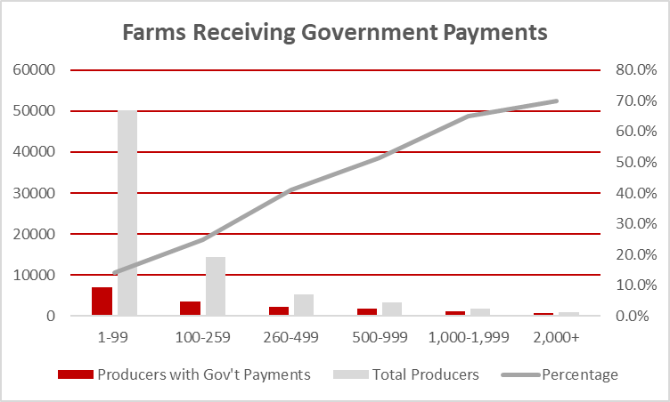
Market Value of Ag Products + Government Payments
21.6% of Ohio operations receive government payments.
14.1% of producers with 1-99 acres receive government payments.
66.8% of farms with >1,000 acres receive government payments.
Source: 2022 Census of Agriculture
Notes:
$136 million reported in 2022 census

Slide 13
Age of Producers
132,912 total producers
Average age of all producers is 56.3
58.4% of producers over the age of 55
34.4% of producers over the age of 65
Source: 2022 Census of Agriculture
Notes:
Year
Age of Principal Operator
2022
2017: 57.1
2012: 56.8
2007: 55.7
2002: 53.8
1997: 52.5
1992 52.0
128,686 total producers in 2017
Average age of all producers is 55.8 in 2017
57.6% of producers over the age of 55 in 2017
29.3% of producers over the age of 65 in 2017

Slide 14
Acres | Operations | Producers | Average Age | Over 55 | Over 65
1-9 | 9,331 | 16,548 | 51.1 | 43.7% | 21.8%
10-49 | 27,225 | 46,425 | 55.9 | 57.3% | 32.9%
50-69 | 6,217 | 10,760 | 57.4 | 61.3% | 36.8%
70-99 | 7,416 | 13,033 | 58.0 | 62.6% | 39.9%
100-139 | 6,216 | 10,665 | 57.6 | 61.7% | 38.1%
140-179 | 3,856 | 6,739 | 58.9 | 65.0% | 42.1%
180-219 | 2,458 | 4,207 | 58.8 | 65.0% | 42.0%
220-259 | 1,940 | 3,449 | 58.7 | 63.6% | 39.9%
260-499 | 5,263 | 9,416 | 58.0 | 64.1% | 37.5%
500-999 | 3,370 | 6,196 | 57.5 | 62.5% | 36.8%
1,000-1,999 | 1,789 | 3,460 | 56.6 | 61.0% | 32.5%
2,000+ | 928 | 2,014 | 55.9 | 56.0% | 32.1%
 | 76,009 | 132,912 | 56.3 | 58.4% | 34.4%

Slide 15
Market Value of Ag Products Sold | Operations | Producers | Average Age | Over 55 | Over 65
Less than $1,000 | 11,465 | 26,802 | 59.2 | 66.7% | 40.3%
$1,000 - $2,499 | 8,508 | 12,088 | 54.0 | 50.9% | 28.2%
$2,500 - $4,999 | 8,611 | 12,833 | 54.9 | 54.0% | 30.6%
$5,000 - $9,999 | 9,055 | 14,088 | 55.4 | 55.5% | 32.7%
$10,000 - $24,999 | 10,107 | 16,715 | 56.2 | 58.4% | 34.1%
$25,000 - $49,999 | 6,784 | 11,507 | 56.3 | 57.8% | 35.9%
$50,000 - $99,999 | 6,149 | 10,755 | 56.6 | 58.6% | 37.1%
$100,000 - $249,999 | 5,905 | 9,961 | 56.7 | 59.7% | 35.8%
$250,000 - $499,999 | 3,589 | 6,480 | 55.8 | 58.6% | 33.7%
$500,000 - $999,999 | 2,557 | 4,785 | 55.3 | 57.8% | 31.9%
$1,000,000 or more | 3,369 | 6,898 | 53.9 | 52.6% | 26.7%
 | 76,009 | 132,912 | 56.3 | 58.4% | 34.4%

Slide 16
IMPLAN Economic Impact Analysis Nancy Bowen-Ellzey and Evelyn Morrison, OSU Extension

Slide 17
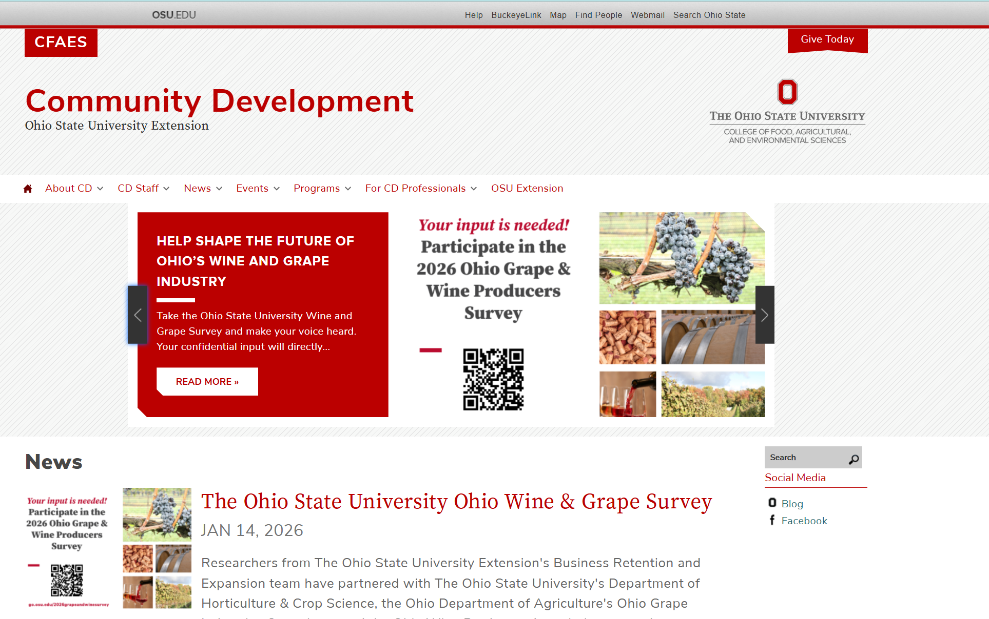
https://comdev.osu.edu/

Slide 18
Contact Information
Nancy Bowen-Ellzey
Associate Professor, Field Specialist, Community Economics The Ohio State University College of Food, Agricultural and Environmental Sciences OSU Extension 4240 Campus Drive
Lima, OH 45804 419-203-4148 Office bowen-ellzey.1@osu.edu / comdev.osu.edu

Slide 19


Slide 20
Ohio Overall Analysis - 2026
Ohio agricultural economic activity supports 139,010 jobs earning $7.6 billion in labor income creating $13.7 billion of economic activity (GDP) and ripples to total output of $26.5 billon.
This activity generates a combined tax revenue of $2.5 billion at the federal, state, and county levels.
These figures are reported in 2026 dollar year.
Source: IMPLAN – Nancy Bowen-Ellzey and Evelyn Morrison, OSU Extension
Notes:
Year
Age of Principal Operator
2022
2017: 57.1
2012: 56.8
2007: 55.7
2002: 53.8
1997: 52.5
1992 52.0
128,686 total producers in 2017
Average age of all producers is 55.8 in 2017
57.6% of producers over the age of 55 in 2017
29.3% of producers over the age of 65 in 2017

Slide 21
Economic Indicators by Impact
Effect Type | Employment | Labor Income | Value Added | Output | Tax Revenue
1 - Direct | 97,714.954 | $4,815,309,763 | $8,187,006,788 | $16,026,573,601 | $1,293,760,503
2 - Indirect | 13,417.54 | $1,101,071,897 | $2,244,679,978 | $5,134,984,882 | $521,984,807
3 - Induced | 27,877.298 | $1,662,395,805 | $3,230,799,254 | $5,340,076,780 | $704,389,067
Totals | 139,009.792 | $7,578,777,466 | $13,662,486,020 | $26,501,635,263 | $2,520,134,378
Source: IMPLAN – Nancy Bowen-Ellzey and Evelyn Morrison, OSU Extension

Slide 22
Overall Analysis - 2026
$26,501,635,263
Output
$13,662,486,020
Contribution to GDP
$2,520,134,378
Tax Revenue
139,010
Employment
$7,578,777,466
Labor Income
Ohio agricultural economic activity supports 139,010 jobs earning $7.6 billion in labor income and creates a value of $13.7 billion. Economic activity in this segment of the analysis generates a combined tax revenue of $2.5 billion at the federal, state, and county level. These figures are reported in 2026 dollar year.

Slide 23
Tax Results
Effect Type | Sub County General | Sub County Special Districts | County | State | Federal | Total
1 - Direct | $64,104,312 | $69,099,385 | $26,732,403 | $185,295,153 | $948,529,251 | $1,293,760,503
2 - Indirect | $26,542,555 | $67,419,930 | $27,570,925 | $131,444,142 | $269,007,255 | $521,984,807
3 - Induced | $34,154,097 | $77,847,788 | $31,690,546 | $157,771,633 | $402,925,004 | $704,389,067
Totals | $124,800,963 | $214,367,102 | $85,993,874 | $474,510,928 | $1,620,461,510 | $2,520,134,378
Source: IMPLAN – Nancy Bowen-Ellzey and Evelyn Morrison, OSU Extension
Notes:
Year
Age of Principal Operator
2022
2017: 57.1
2012: 56.8
2007: 55.7
2002: 53.8
1997: 52.5
1992 52.0
128,686 total producers in 2017
Average age of all producers is 55.8 in 2017
57.6% of producers over the age of 55 in 2017
29.3% of producers over the age of 65 in 2017

Slide 24
Overall Tax Breakdown - 2026
$1,620,461,510
Federal Tax Revenue
$474,510,928
State Tax Revenue
$85,993,874
County Tax Revenue
$214,367,102
Sub County Special District Tax Revenue
$124,800,963
Sub County General Tax Revenue
In total, impacts within this analysis support tax revenues of $1.6 billion at the federal level, $474 million at the state level, $85 million at the county level, $214 million at the sub-county special district level and $124 million at the sub-county general level. These figures are reported in 2026 dollar year.

Slide 25
A Look at Eastern Ohio Ohio Agriculture

Slide 26
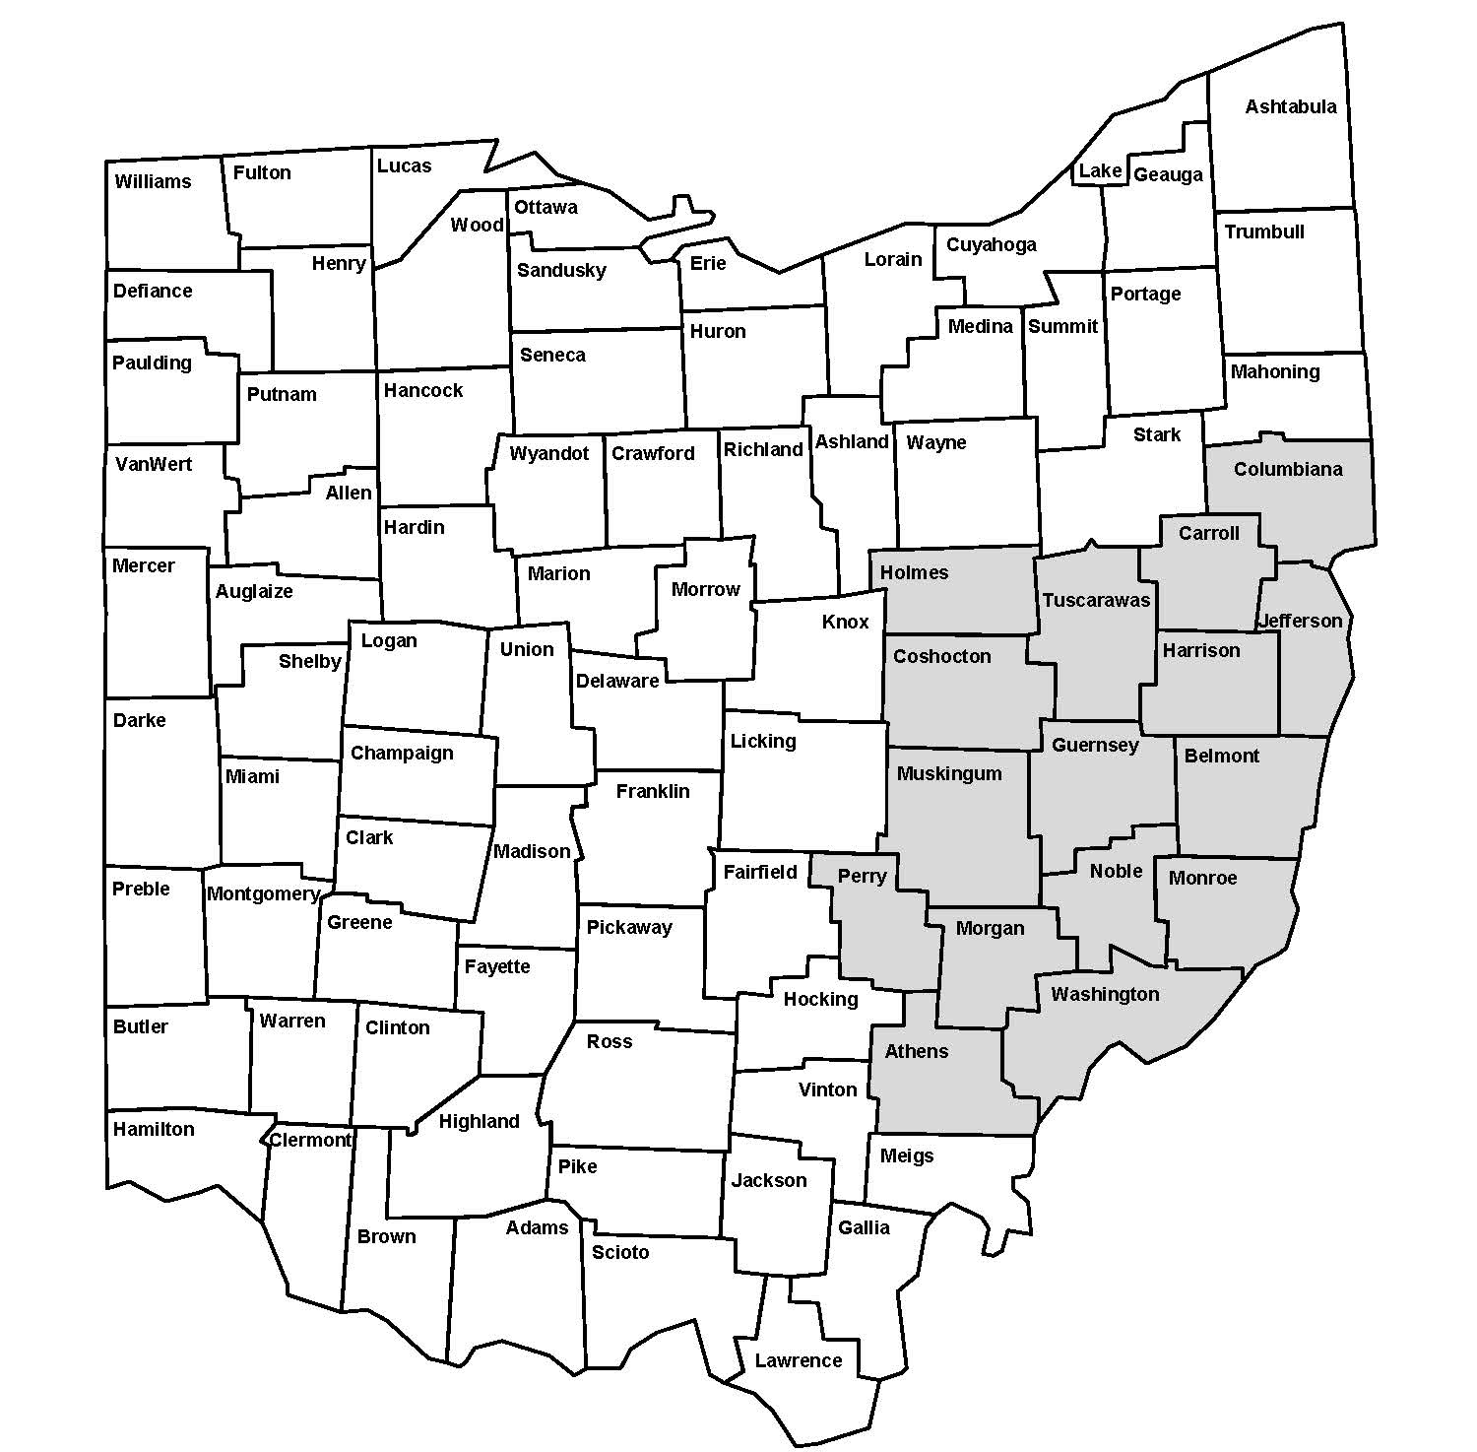
Eastern Ohio Development Alliance Counties
Athens, Belmont, Carroll, Columbiana, Coshocton, Guernsey, Harrison, Holmes, Jefferson, Monroe, Morgan, Muskingum, Noble, Perry, Tuscarawas, and Washington

Slide 27
Eastern Ohio Agriculture
Number of Farms: 14,567 (19.2%)
Average per County: 910 farms (482 – 1736)
Total Acres: 1,973,485 (14.5%)
Average Acres: 147.8 acres (106-215)
Market Value of
Ag Products Sold: $1.2 Billion (7.8%)
Average/Farm: $80,784
Source: 2022 Census of Agriculture - https://www.nass.usda.gov/Publications/AgCensus/2022/Online_Resources/County_Profiles/Ohio/
Notes:
Farms down from 77,805 to 76,009
Land in farm down from 13,965,295 to 13, 652,346
Acreage size up from 179 to 180
Market Value of Ag Products sold up from $9.7 billion to $15.4
Average per farm is up to $202,767 from $124,572

Slide 28
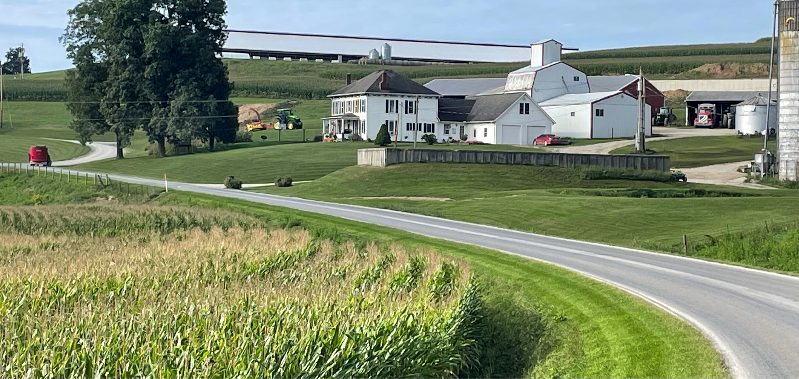
Eastern Ohio Agriculture
Estimated value of land and buildings is $12.3 billion. (11.2%)
Estimated machinery is $1.5 billion (12.6%)
Source: 2022 Census of Agriculture

Slide 29
County | Farms | Land & Buildings | Machinery
Athens | 663 | $ 440,647,038 | $ 50,246,000
Belmont | 756 | $ 620,741,772 | $ 79,870,000
Carroll | 817 | $ 669,194,079 | $ 92,183,000
Columbiana | 1129 | $ 1,136,275,276 | $ 167,315,000
Coshocton | 1251 | $ 1,202,791,464 | $ 123,789,000
Guernsey | 1055 | $ 767,372,185 | $ 96,828,000
Harrison | 482 | $ 562,435,196 | $ 58,882,000
Holmes | 1736 | $ 1,810,104,632 | $ 154,719,000
Jefferson | 541 | $ 420,491,709 | $ 58,187,000
Monroe | 731 | $ 415,498,938 | $ 71,994,000
Morgan | 571 | $ 407,454,180 | $ 58,194,000
Muskingum | 1301 | $ 1,110,464,647 | $ 135,406,000
Noble | 596 | $ 424,808,536 | $ 54,175,000
Perry | 696 | $ 471,072,288 | $ 61,649,000
Tuscarawas | 1154 | $ 1,178,432,488 | $ 143,268,000
Washington | 1088 | $ 686,998,016 | $ 87,626,000
Total | 14567 | $ 12,324,782,444 | $ 1,494,331,000

Slide 30
IMPLAN Economic Impact Analysis Nancy Bowen-Ellzey and Evelyn Morrison, OSU Extension

Slide 31
East Ohio Overall Analysis - 2026
Agricultural economic activity in the EODA region supports 18,551 jobs earning $760 million in labor income creating $1.2 billion of economic output (GDP) and ripples to a total output of $2.6 billion.
This activity generates a combined tax revenue of $285 million at the federal, state, and county level.
These figures are reported in 2026 dollar year.
Source: IMPLAN – Nancy Bowen-Ellzey and Evelyn Morrison, OSU Extension
Notes:
Agricultural economic activity in the Eastern Ohio Development Alliance Region supports 18,550.607 jobs earning $760,607,762 in Labor Income and creates a value of $1,204,510,948. Economic activity generates a combined tax revenue of $285,067,516 at the federal, state, and county level. These figures are reported in 2026 dollar year.

Slide 32
Economic Indicators by Impact
Effect Type | Employment | Labor Income | Value Added | Output | Tax Revenue
1 - Direct | 15,414.095 | $589,565,159 | $841,019,553 | $1,808,310,596 | $194,047,995
2 - Indirect | 1,034.383 | $70,423,488 | $145,662,729 | $377,257,098 | $39,423,394
3 - Induced | 2,102.129 | $100,619,115 | $217,828,666 | $367,225,907 | $51,596,127
Totals | 18,550.607 | $760,607,762 | $1,204,510,948 | $2,552,793,600 | $285,067,516
Source: IMPLAN – Nancy Boz and Evelyn Morrison, OSU Extension
Notes:
Year
Age of Principal Operator
2022
2017: 57.1
2012: 56.8
2007: 55.7
2002: 53.8
1997: 52.5
1992 52.0
128,686 total producers in 2017
Average age of all producers is 55.8 in 2017
57.6% of producers over the age of 55 in 2017
29.3% of producers over the age of 65 in 2017

Slide 33
East Ohio Overall Analysis - 2026
$2,552,793,600
Output
$1,204,510,948
Contribution to GDP
$285,067,516
Tax Revenue
18,551
Employment
$760,607,762
Labor Income
Agricultural economic activity in the Eastern Ohio Development Alliance region supports 18,551 jobs earning $760 million in labor income and creates a value of $1.2 billion. Economic activity generates a combined tax revenue of $285 million at the federal, state, and county level. These figures are reported in 2026 dollar year.

Slide 34
East Ohio Tax Results
Effect Type | Sub County General | Sub County Special Districts | County | State | Federal | Total
1 - Direct | $6,585,104 | $16,053,091 | $8,479,454 | $42,438,129 | $120,492,217 | $194,047,995
2 - Indirect | $1,620,666 | $5,177,419 | $2,756,872 | $11,751,371 | $18,117,066 | $39,423,394
3 - Induced | $1,960,971 | $5,980,091 | $3,182,158 | $13,867,500 | $26,605,407 | $51,596,127
Totals | $10,166,741 | $27,210,602 | $14,418,483 | $68,057,001 | $165,214,690 | $285,067,516
Source: IMPLAN – Nancy Boz and Evelyn Morrison, OSU Extension
Notes:
Year
Age of Principal Operator
2022
2017: 57.1
2012: 56.8
2007: 55.7
2002: 53.8
1997: 52.5
1992 52.0
128,686 total producers in 2017
Average age of all producers is 55.8 in 2017
57.6% of producers over the age of 55 in 2017
29.3% of producers over the age of 65 in 2017

Slide 35
East Ohio Tax Breakdown - 2026
$165,214,690
Federal Tax Revenue
$68,057,001
State Tax Revenue
$14,418,483
County Tax Revenue
$27,210,602
Sub County Special District Tax Revenue
$10,166,741
Sub County General Tax Revenue
In total, impacts within this analysis support tax revenues of $165 million at the federal level, $68 million at the state level, $14 million at the county level, $27 million at the sub-county special district level and $10 million at the sub-county general level. These figures are reported in 2026 dollar year.

Slide 36

Farm Office (farmoffice.osu.edu)

Slide 37


Ohio Farm Resolution Services
Cultivating solutions for farms and farm families
farmoffice.osu.edu
moore.301@osu.edu
614-247-8260
Notes:
And finally as we close this session on the dialogue phase, please remember If you need help along the way in building your capacity as a family to have crucial conversations---you can turn to the Ohio Farm Resolution Services for assistance---just reach out to Robert Moore and he can share how we can help you be better communicators!

Slide 38
Contact Information
David Marrison
Professor, OSU Extension
Field Specialist, Farm Management
Interim Director of the OSU Farm Financial Management and Policy Institute
740-722-6073
marrison.2@osu.edu

Slide 39
The Changing Landscape of Agriculture

Slide 40
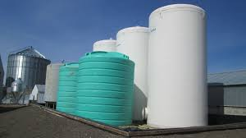
Top Ten Challenges for Ohio Ag
Volatile Input Costs (Fertilizer, Fuel, Chemicals)
Weather Extremes, Drought, and Climate Variability
Tightening Farm Profit Margins
Trade Policy Uncertainty
Labor Shortages and Rising Labor Costs
Notes:
Top Ten Challenges Facing Ohio Farmers in 2026 & the Coming Decade
1. Volatile Input Costs (Fertilizer, Fuel, Chemicals)
Ohio farmers continue struggling with rising and unstable input costs—especially fertilizer, where prices increased again in 2025 and remain a major 2026 planning concern. Nationwide analysis also shows rising input costs paired with stagnant commodity prices, leading to poor margins and recession‑like conditions. [brownfieldagnews.com] [nationwide.com]
2. Weather Extremes, Drought, and Climate Variability
Ohio is experiencing multi‑year drought conditions, especially in northwest counties, reducing soil moisture and affecting crop establishment. Extended wet springs and erratic planting windows (cold snaps, excessive rain) have compressed planting seasons, caused late emergence, and heightened disease risk. [farmanddairy.com] [forwardpathway.us]
3. Tightening Farm Profit Margins
Farm income improvements mask deeper issues: margins are strained due to input‑price mismatches, weaker commodity prices, and reliance on government payments rather than markets. Farmers are experiencing four straight years of poor profit margins, with red ink projected into 2026. [ohiobusine...review.com] [nationwide.com]
4. Trade Policy Uncertainty and Weak Export Markets
Soybean demand from China has fallen to the lowest level since 2018, impacting Ohio’s largest export commodity. Tariff volatility and global trade disputes remain top concerns, complicating long‑term planning and market access. [farmanddairy.com] [m.farms.com]
5. Labor Shortages and Rising Labor Costs
Ohio farms relying on H‑2A labor are facing escalating wage rates, squeezing already‑tight margins. Legislative uncertainty around farm labor policy amplifies workforce instability. [ohiobusine...review.com] [ofbf.org]

Slide 41
Top Ten Challenges for Ohio Ag
Farmland Loss, Development Pressure, and Land‑Use Conflicts
Disease Pressure in Crops and Emerging Pest Risks
Need for New Market Development & Processing Capacity
Infrastructure Gaps: Broadband, Transportation, and Supply Chains
Policy Uncertainty: Farm Bill, Renewable Fuels, and Regulatory Shifts
Notes:
Top Ten Challenges Facing Ohio Farmers in 2026 & the Coming Decade
6. Farmland Loss, Development Pressure, and Land‑Use Conflicts
Urban expansion, solar developments, data centers, and industrial projects continue to remove productive farmland or compete for land access. The Ohio Farm Bureau highlights farmland preservation and landowner protections as top 2026 priorities due to accelerating development pressure. [ofbf.org]
7. Disease Pressure in Crops and Emerging Pest Risks
Corn and soybean diseases—such as Tar Spot—have increased due to challenging weather patterns. Ohio has launched statewide surveillance to track spread and yield impacts. Excessive moisture increases risk for seedling diseases and Fusarium head blight. [agcrops.osu.edu] [forwardpathway.us]
8. Need for New Market Development & Processing Capacity
Ohio Soybean Council leaders emphasize that future profitability will depend on domestic demand growth such as advanced biomanufacturing and new uses for agricultural feedstocks. Long‑term structural changes may reduce U.S. competitiveness in global commodity markets, requiring Ohio farmers to shift toward differentiated products and new value chains. [farmanddairy.com] [ofbf.org]
9. Infrastructure Gaps: Broadband, Transportation, and Supply Chains
Rural broadband and transportation infrastructure remain major constraints, affecting precision agriculture adoption, market access, and efficiency. Supply chain instability following years of disruptions continues to affect availability and cost of equipment and inputs. [ofbf.org] [woub.org]
10. Policy Uncertainty: Farm Bill, Renewable Fuels, and Regulatory Shifts
The delay in passing a new federal farm bill adds uncertainty to risk‑management programs, conservation incentives, and insurance supports. Biofuels policy, environmental regulations, and energy‑related land‑use policies are major “wild cards” that could drastically influence future income.

Slide 42
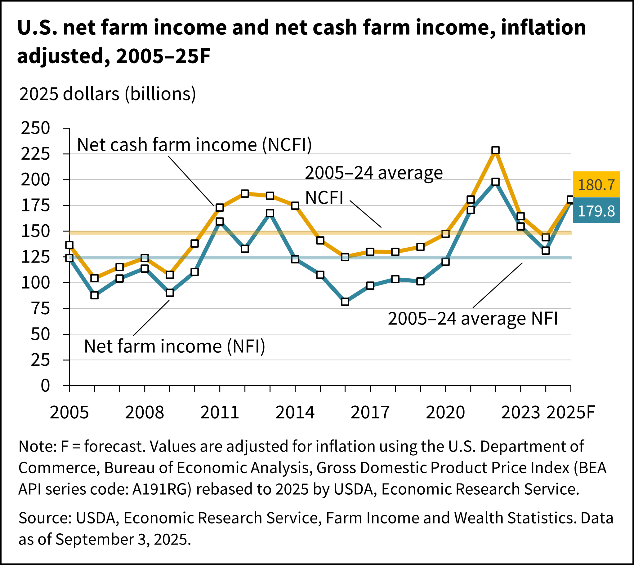
Notes:
To gain perspective, we can look at data from the Economic Research Service from the United States Department of Agriculture.
Net farm income, a broad measure of profits, is forecasted to increase in 2025 to 179.8 billion which is 40.7% higher that in 2024 (or 37.2 percent for inflation adjusted dollars).
Notes:
Forecast at $179.8 billion for 2025, net farm income would be $52.0 billion (40.7 percent) higher than in 2024. Net cash farm income is forecast at $180.7 billion for 2025, an increase of $40.1 billion (28.5 percent) relative to 2024 (not adjusted for inflation).
In inflation-adjusted 2025 dollars, net farm income is forecast to increase by $48.8 billion (37.2 percent) from 2024 to 2025, and net cash farm income is forecast to increase by $36.5 billion (25.3 percent) compared with the previous year. If realized, both measures in 2025 would be above their 2005–24 averages (in inflation-adjusted dollars).

Slide 43
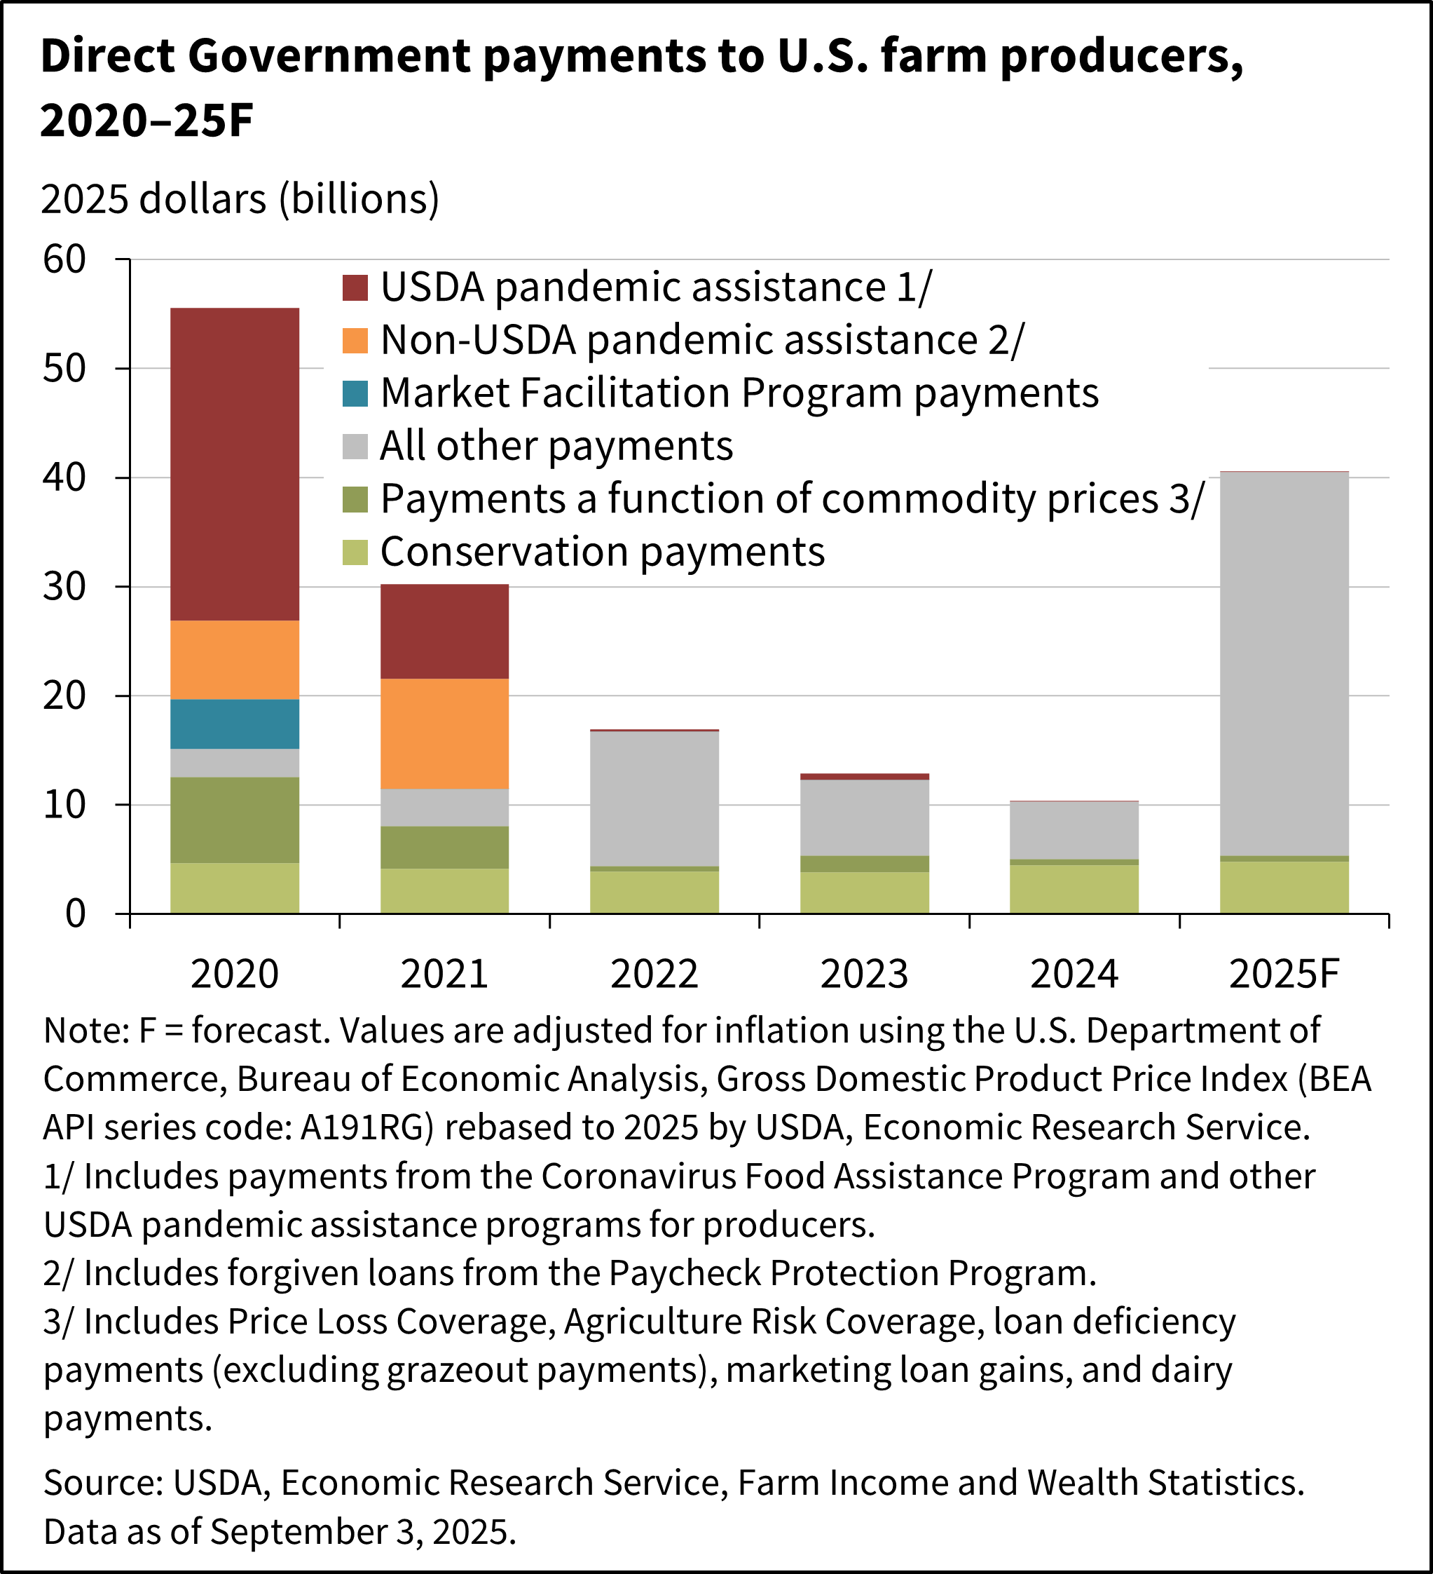
Notes:
So where is our large increase in net farm income coming from?......well Direct Government farm payments are forecast at $40.5 billion for 2025, a $30.4-billion increase from 2024. The forecast increase is largely because of supplemental and ad hoc disaster assistance to farmers and ranchers from the American Relief Act of 2025. Direct Government farm payments include Federal farm program payments paid to farmers and ranchers but exclude U.S. Department of Agriculture (USDA) loans and insurance indemnity payments made by the Federal Crop Insurance Corporation (FCIC).
Direct Government farm program payments are those made by the Federal Government to farmers and ranchers with no intermediaries. Most direct payments to farmers and ranchers are administered by the USDA using the Farm Bill but can also come from supplemental programs authorized by the U.S. Congress. Government payments discussed here do not include Federal Crop Insurance Corporation (FCIC) indemnity payments (listed as a separate component of farm income) and USDA loans (listed as a liability in the farm sector’s balance sheet). Direct Government farm program payments are forecast at $40.5 billion for 2025, a $30.4 billion increase from the $10.1 billion total for 2024. This overall increase reflects higher anticipated payments from supplemental and ad hoc disaster assistance, mainly from the funding authorized in the Disaster Relief Supplemental Appropriations Act, 2025 contained in the American Relief Act, 2025.
Will be called: Emergency Commodity Assistance Program (E-CAP)
Based on 2024 production as reported to Farm Service Agency.
100% planted and 50% prevent plant acres
Payment rates (note: Secretary of Ag has final say):
Corn- $42.51 Soybean- $29.50
Wheat- $30.69 Alfalfa/Hay- $0
Supplemental and ad hoc disaster assistance payments in 2025 are forecast at $35.2 billion and consist primarily of payments from the Disaster Relief Supplemental Appropriations Act of 2025. The act included the Economic Assistance for Producers and other payments related to losses due to natural disasters in 2023 and 2024.
Conservation payments from the financial assistance programs of USDA's Farm Service Agency and Natural Resources Conservation Service (NRCS) are expected to be $4.8 billion in 2025, an increase of $446.3 million (10.3 percent) from the 2024 level. The increase in conservation payments is due to an increase in payments from NRCS programs.
Farm bill payments that are a function of commodity prices are forecast at $550.4 million for 2025, largely unchanged from 2024. Payments under the Agriculture Risk Coverage (ARC) and Dairy Margin Coverage programs are forecast to decrease, while payments from the Price Loss Coverage (PLC) program are forecast to increase relative to 2024.

Slide 44
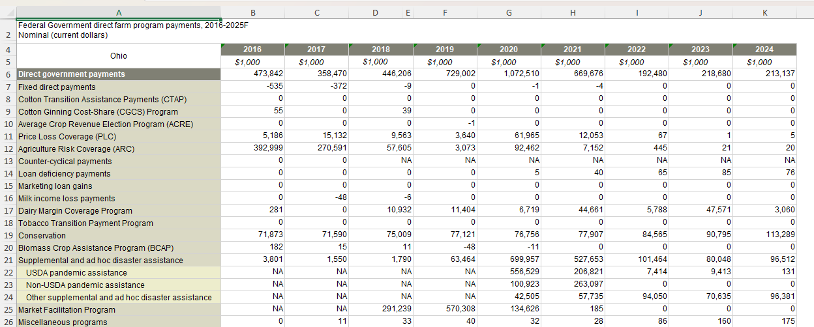
Ohio Payment History
Source: Economic Research Service
Notes:
Footnotes
Data as of September 3, 2025. F = Forecast values. NA = Data are not available/applicable. Values are rounded to the nearest thousand. When 'Real (2025 dollars)' is selected, nominal values are adjusted for inflation using the U.S. Bureau of Economic Analysis Gross Domestic Product Price Index (BEA API series code: A191RG) rebased to 2025 by USDA, Economic Research Service. U.S. government direct payments by program are net payments reflecting: (1) gross payments from the U.S. government to the farm sector; (2) payments returned to the U.S. government by the farm sector; and (3) accounting adjustments. A negative value indicates payments returned exceeded gross payments during the calendar year. Beginning in 2016, Commodity Certificate Exchange Gains are included in the category Marketing Loan Gains. Dairy Margin Protection Program (MPP-Dairy) payments are included in the category Dairy Margin Coverage Program, which replaced the MPP-Dairy in 2019. Supplemental and ad hoc disaster assistance includes assistance from COVID-19 pandemic assistance programs and other ad hoc and emergency programs that make direct payments to producers. USDA pandemic assistance includes payments from the Coronavirus Food Assistance Programs (CFAP) and other pandemic assistance to producers, while non-USDA pandemic assistance represents forgiven loan amounts from the Small Business Administration’s Paycheck Protection Program (PPP). The “other supplemental and ad hoc disaster assistance” line item has included farm bill designated disaster programs as well as ad hoc programs, including the Wildfire and Hurricane Indemnity Program, Emergency Relief Program, Quality Loss Adjustment Program, Emergency Livestock Relief Program, Assistance to Distressed Borrowers, and payments from the American Relief Act of 2025. Source: USDA, Economic Research Service estimates and forecasts developed using data from the USDA’s World Agricultural Supply and Demand Estimates, National Agricultural Statistics Service, Farm Service Agency, Risk Management Agency, Natural Resources Conservation Service, Animal and Plant Health Inspection Service, internal commodity projections, and other non-USDA sources.

Slide 45
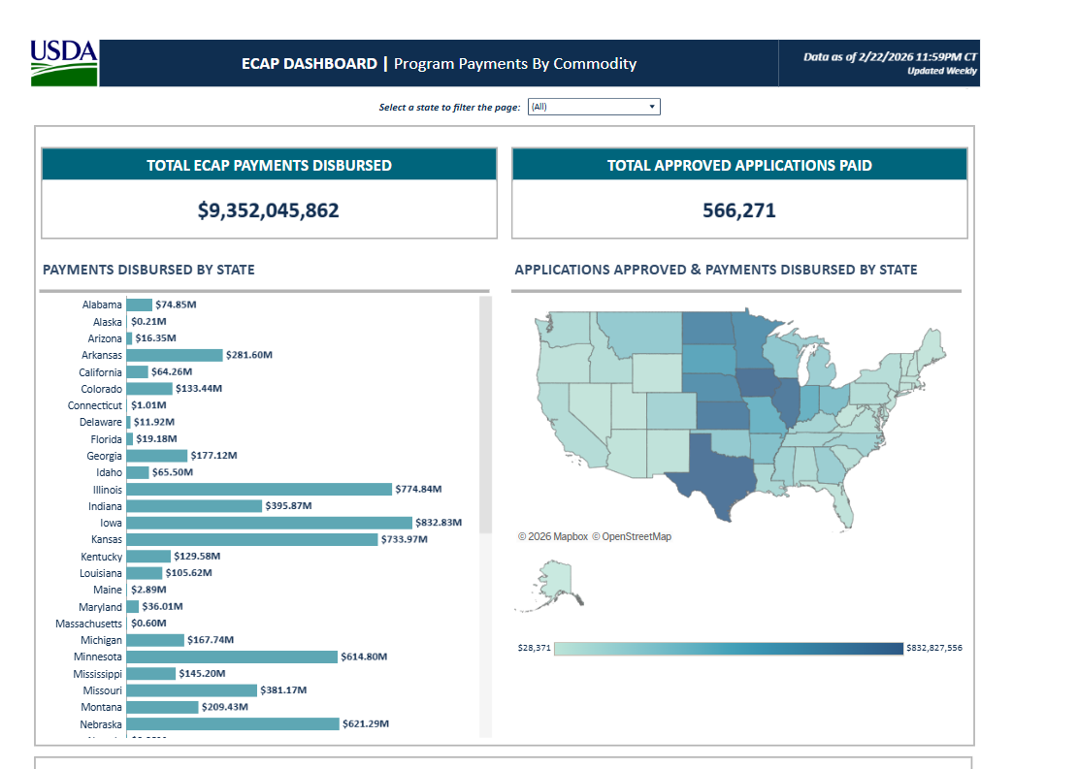
Emergency Commodity Assistance Program (ECAP)
Ohio - $302M to 27,983 applicants (36.8%)
Notes:
USDA’s Farm Service Agency is issuing up to $10 billion in direct payments to eligible agricultural producers of eligible commodities for the 2024 crop year through the Emergency Commodity Assistance Program (ECAP). These one-time economic assistance payments will help commodity producers mitigate the impacts of increased input costs and falling commodity prices.
$9,321,168,010 for $564,796 applicants (Billion)
Ohio- $301,490,615 for 27,971 applicants of which $146.89M for corn and $139.24M for beans and $14.67M for Wheat
Indiana- $395,417,924 to 29,691 applicants of which $218.9M for corn and $166.89M for beans and $7.94M for Wheat
Payment rates--$42.91 for corn, $ 29.76 for soybeans, $30.69 for wheat, $77.66 for oats
Emergency Commodity Assistance Program (ECAP) is helping farmers recover from the economic hardships of 2024. This program distributed more than $9.3 billion to over 560,000 farmers for soy, corn, sorghum, and other row crops. March 19, 2025: Sign-up began and August 15, 2025: Sign-up ends
Emergency Commodity Assistance Program (ECAP) Dashboard
The Emergency Commodity Assistance Program (ECAP) provides economic loss assistance for covered commodities based on 2024 planted and prevented planted acres.
Important Dates
March 19, 2025: Sign-up began
August 15, 2025: Sign-up ends

Slide 46
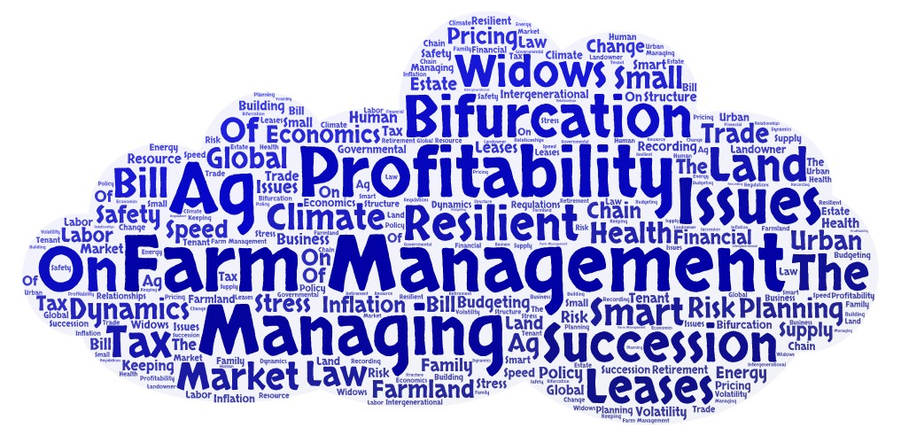
Notes:
Where Does “Bifurcation” Fit Into Ohio’s Agricultural Challenges?
In agricultural economics and rural development, bifurcation refers to a system splitting into two diverging paths. In Ohio agriculture, this concept shows up in three major ways, all strongly reflected in the sources used earlier.
1. Bifurcation of Farm Profitability
Several sources show the gap between high‑performing farms and financially stressed farms is widening, creating two distinct groups:
Some farms benefit from strong land values and government payments, cushioning income. [nationwide.com]
Others face persistent negative margins, high input costs, stagnant prices, and recession-like conditions. [nationwide.com]
This creates a bifurcated financial landscape:
Group 1: Capital‑strong farms able to adopt new technology, expand, and withstand volatility.
Group 2: Margin‑tight farms increasingly vulnerable to shocks, policy changes, and market shifts.
2. Bifurcation of Land Use: Agriculture vs. Development
Ohio Farm Bureau identifies severe development pressure from:
Data centers
Warehouses
Solar and energy‑intensive projects [ofbf.org]
This leads to two diverging land‑use futures:
Agricultural preservation: Efforts to protect farmland and maintain rural landscapes.
Conversion to non‑farm use: Rapid growth of industrial, energy, or urban development consuming farmland.
This bifurcation means the map of agricultural Ohio is splitting—some regions intensifying farming, others losing farmland irreversibly.
3. Bifurcation of Markets and Farm Strategy
Global competition, weakened exports, and policy uncertainty create another split:
One path pushes farms toward commodity production, remaining price‑takers in volatile global markets.
The other path encourages diversification into:
Biomanufacturing feedstocks
New product uses
Value‑added processing [farmanddairy.com]
Sustainability‑driven crop traits [ofbf.org]
This represents a strategic bifurcation:
Stay in bulk commodity markets (higher risk, lower margins).
Shift to differentiated or value‑added markets (potentially higher margins, more resilience).
Summary: How Bifurcation Fits Into the Challenges Ahead
Bifurcation is not a separate challenge — it’s a framework that helps us interpret multiple challenges Ohio farmers face. Those challenges are pushing the agricultural sector into two diverging trajectories in:
• Profitability (strong vs. struggling farms)
• Land use (preserved farmland vs. development conversion)
• Market orientation (commodity vs. value‑added)
Understanding this split helps Extension, policymakers, and farmers anticipate which operations are most vulnerable, and where strategic intervention or innovation is most needed.

Slide 47

Bifurcation
Farm Profitability
Land Use: Agriculture vs Development
Markets and Farm Strategy
Notes:
Where Does “Bifurcation” Fit Into Ohio’s Agricultural Challenges?
In agricultural economics and rural development, bifurcation refers to a system splitting into two diverging paths. In Ohio agriculture, this concept shows up in three major ways, all strongly reflected in the sources used earlier.
1. Bifurcation of Farm Profitability
Several sources show the gap between high‑performing farms and financially stressed farms is widening, creating two distinct groups:
Some farms benefit from strong land values and government payments, cushioning income. [nationwide.com]
Others face persistent negative margins, high input costs, stagnant prices, and recession-like conditions. [nationwide.com]
This creates a bifurcated financial landscape:
Group 1: Capital‑strong farms able to adopt new technology, expand, and withstand volatility.
Group 2: Margin‑tight farms increasingly vulnerable to shocks, policy changes, and market shifts.
2. Bifurcation of Land Use: Agriculture vs. Development
Ohio Farm Bureau identifies severe development pressure from:
Data centers
Warehouses
Solar and energy‑intensive projects [ofbf.org]
This leads to two diverging land‑use futures:
Agricultural preservation: Efforts to protect farmland and maintain rural landscapes.
Conversion to non‑farm use: Rapid growth of industrial, energy, or urban development consuming farmland.
This bifurcation means the map of agricultural Ohio is splitting—some regions intensifying farming, others losing farmland irreversibly.
3. Bifurcation of Markets and Farm Strategy
Global competition, weakened exports, and policy uncertainty create another split:
One path pushes farms toward commodity production, remaining price‑takers in volatile global markets.
The other path encourages diversification into:
Biomanufacturing feedstocks
New product uses
Value‑added processing [farmanddairy.com]
Sustainability‑driven crop traits [ofbf.org]
This represents a strategic bifurcation:
Stay in bulk commodity markets (higher risk, lower margins).
Shift to differentiated or value‑added markets (potentially higher margins, more resilience).
Summary: How Bifurcation Fits Into the Challenges Ahead
Bifurcation is not a separate challenge — it’s a framework that helps us interpret multiple challenges Ohio farmers face. Those challenges are pushing the agricultural sector into two diverging trajectories in:
• Profitability (strong vs. struggling farms)
• Land use (preserved farmland vs. development conversion)
• Market orientation (commodity vs. value‑added)
Understanding this split helps Extension, policymakers, and farmers anticipate which operations are most vulnerable, and where strategic intervention or innovation is most needed.

Slide 48



Slide 49
Contact Information
David Marrison
Professor, OSU Extension
Field Specialist, Farm Management
Interim Director of the OSU Farm Financial Management and Policy Institute
740-722-6073
marrison.2@osu.edu

